Slide 1
Use Case – HTTP Request
Calling Weather API – OpenWeatherMap API
Topics
Deserialize JSON
HTTP Request

Slide 2
Problem Statement
User needs weather conditions of a city, below details are needed
Temperature
Max_temp
Min_temp
humidity
Solution:
Take city input from the user, save API key in Orchestrator Asset and call it when required
Get weather details using Openweathermap.org Current weather data API by calling using city name and metric system values.
Use necessary exception handing at logical points that might fail

Slide 3
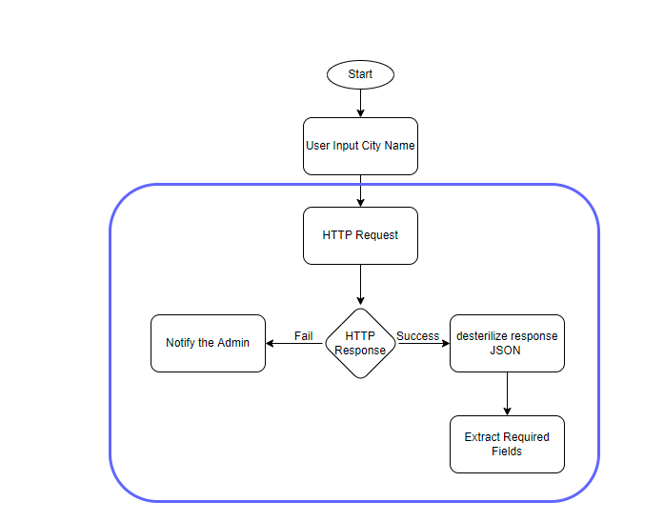
Workflow Design

Slide 4
Requirements
UiPath Package
UiPath.WebAPI.Activites
OpenWeatherMap
https://openweathermap.org/
Create a user log in to get free API key.
Use this key to make API calls using HTTP request to get weather
Hint
Environment.NewLine will add new line in logs

